Slide 1
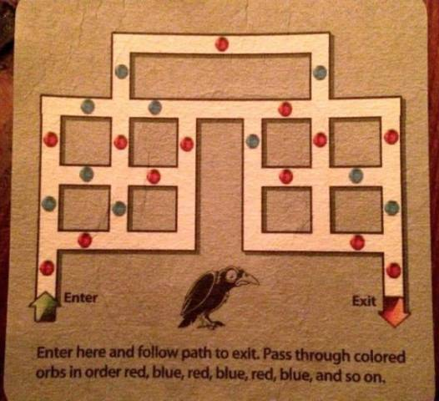
Here is a puzzle I found on a t-shirt
The task, is to go from start to finish, alternating the colors of the “orbs” you pass…

Slide 2
.. So this partial solution is not legal, since I have past two blues in a row…

Slide 3
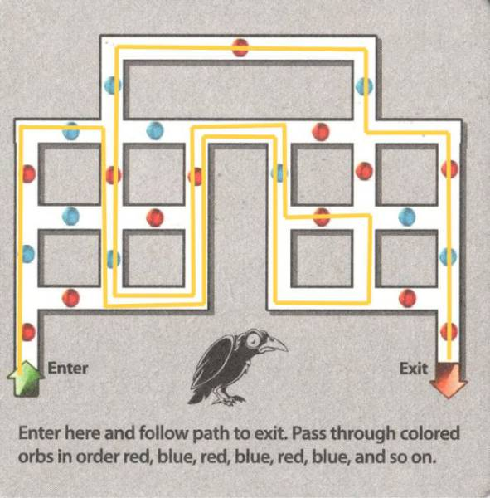
Here is a solution (I am not sure if it is unique)

Slide 4
To Think About
Assume we are to solve this with blind search..
How would you represent the states and the operators?
What is the branching factor?
What is the diameter? Can you get it exactly, or at least upper and/or lower bounds?
Which blind search algorithm would you use?

Slide 5
The states should be the intersections. It is only there that we have a choice.
Here choices are operators.
For each state we need to know..
F
H
I
M
Possible operators allowed
For example:
From C, we can get to B, E or F
From A, we can get to B
C
E
G
J
L
N
B
D
K
O
A
P

Slide 6
We also need to know the parity for each operator.
That is to say, we need to know the last color visited.
For example:
For node F
If C was parent, last color was Blue
If H was parent, last color was Blue
If M was parent, last color was Blue
If E was parent, last color was Red
F
H
I
M
C
E
G
J
L
N
B
D
K
O
A
P

Slide 7
For node F
If C was parent, last color was Blue
If H was parent, last color was Blue
If M was parent, last color was Blue
If E was parent, last color was Red
Given the above, we can list the legal operators
IF last color was Blue
legal operators = { E }
ELSE
legal operators = { C, M , H}
END
F
H
I
M
C
E
G
J
L
N
B
D
K
O
A
P

Slide 8
What can we say about the branching factor?
The are some four-way intersections, but you can never go back (because the last color you saw, would be seen again).
So the branching factor is at most three for the four-way intersections, and there are four of them.
The are some three-way intersections, but again you can never go back.
So the branching factor is at most two for the three-way intersections, and there are twelve of them¹.
So an estimate for the branching factor is
b = (12/16 * 2) + (4/16*3) = 2.25.
This is actually an upper bound.
A
Start
B
C
D
E
F
B
N
L
O
P
Goal!
¹Really should say, at most 12, because A has only one choice

Slide 9
What can we say about the branching factor?
The are some four-way intersections, but you can never go back (because the last color you saw, would be seen again).
So the branching factor is at most three. That is good enough an estimate.
What can we say about the depth?
Lets do a lower bound.
If I take away all the colors, then I can solve this with ten moves: A, B, C, F , H, I, M, L, N, O, P
So 10 is a lower bound.
Lets do an upper bound.
If we count the number of intersections, we might guess 16. However, with a little introspection, we can see that:
We might have to visit some intersections twice, each time from a different parent, and each time going a different way.
We never have to visit an intersection twice!
So an upper bound is d = (16 * 2) = 32.
A
Start
B
C
D
E
F
B
N
L
O
P
Goal!

Slide 10
Which algorithm should we use?
How many nodes do we have to check?
Assume we take one nanosecond to test each state we pop off NODES.
Assume the worst case
We have b = 2.25 and d = 32. (2.25^32) nanosecond = 3.1 minutes
Assume the best case
We have b = 2.25 and d = 10 (2.25^10) nanosecond = 3.3 microseconds
Assume the actual depth is half way between best and worst case
We have b = 2.25 and d = 24 (2.25^24) nanosecond = 0.28 seconds
It probably does not matter what algorithm we use. We are not likely to run out of space or time. Likewise, I would not bother to optimize my code.
However, this assumes we solving the puzzle once. The similar “google maps” problem needs to be solved millions of times a day, so for that problem, we would optimize the code very carefully.

